Slide 1
Good morning! While we wait to begin…
Connect to WIFI:
Network: MSFTGuest
Event Code: msevent071gu
If you have trouble getting to the connection page, try: www.msftconnecttest.com/redirect
Ensure your subscription is setup using the pass provided.
Ensure you have Visual Studio or VS Code installed.

Slide 2
Azure DevOps Workshop
July 31 – Aug 1, Dallas TX
Stephen T. Mann
Cloud Solution Architect

Slide 3
Agenda
Day 1:
Azure DevOps: Introduction (How Microsoft does DevOps)
Azure Repos: Introduction
Azure Repos: Branching & Policies
Lunch
Azure Boards: Agile Project Management
Azure Artifacts: Enterprise Package Management
Day 2:
Azure Pipelines: Continuous Integration
Azure Pipelines: Continuous Delivery
Azure Pipelines: Continuous Delivery Part 2
Lunch
Azure Monitoring: Application Insights

Slide 4
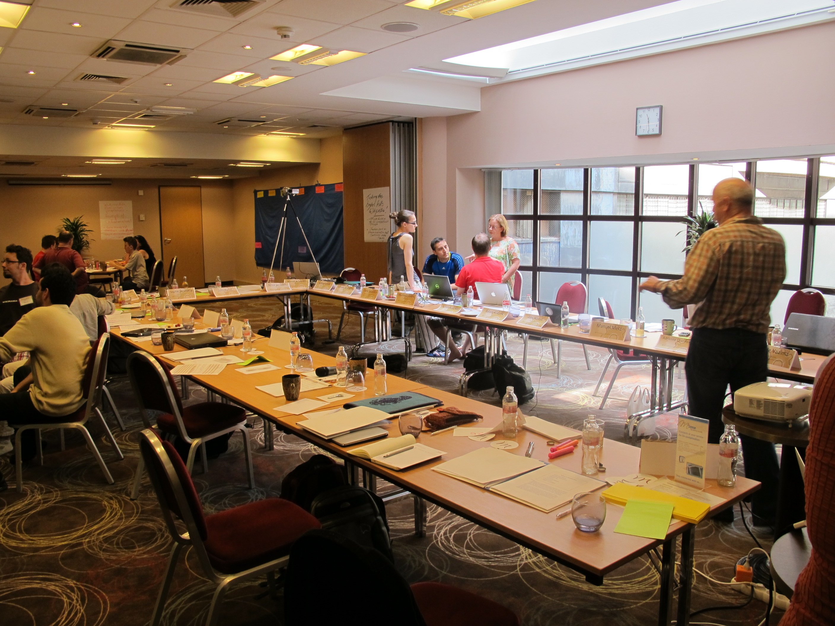

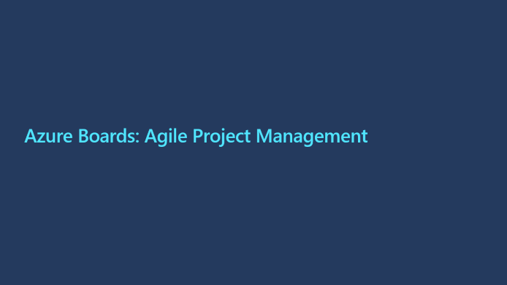
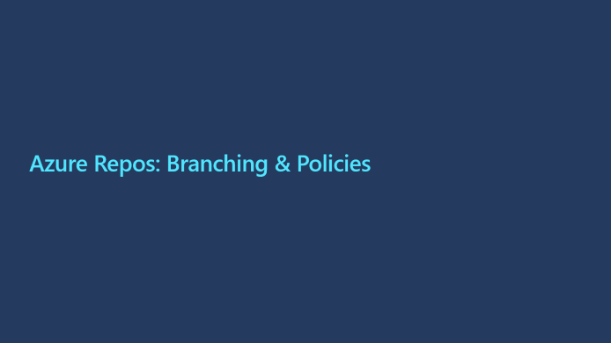
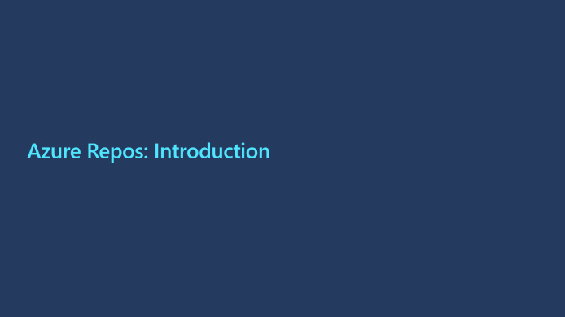
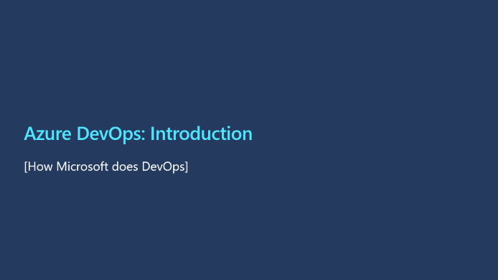
Day 1

Slide 5
Azure DevOps: Introduction
[How Microsoft does DevOps]

Slide 6
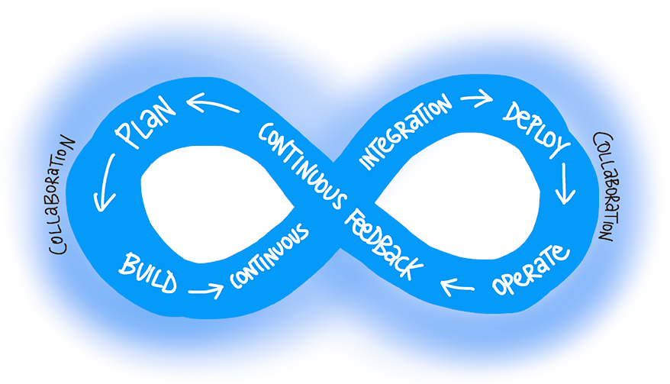
What is “DevOps”?
“DevOps is the union of people, process, and products to enable continuous delivery of value to our end users.” - Sam Guckenheimer
Joining Development and Operations
Multidisciplinary teams that now work together with shared and efficient practices and tools.
Essential DevOps practices
Agile planning
Continuous integration
Continuous delivery
Monitoring of applications
DevOps Learning Resources:
https://aka.ms/devops

Slide 7

How Microsoft does DevOps.
Agile principals in practice
Moving to cloud cadence
One Engineering System - (1ES)
Live-Site Culture (or a Production-First Mindset)
Branching
Trunk based branching https://trunkbaseddevelopment.com/
Testing
Martin Woodward
Principle Program Manger

Slide 8

Azure DevOps (the product formerly known as VSTS)
Azure DevOps Services is the cloud offering that provides a scalable, reliable, and globally available hosted service. It's backed by a 99.9% SLA, monitored by our 24/7 operations team, and available in local data centers around the world.
Azure DevOps Server is the on-premises offering that's built on a SQL Server back end. Companies usually choose on-premises when they need their data to stay within their network or when they want access to SQL Server reporting services that integrate with Azure DevOps data and tools.
Although both offerings provide the same essential services, compared with Azure DevOps Server, Azure DevOps Services offers the following added benefits:
Simplified server management.
Immediate access to the latest and greatest features
Improved connectivity with remote sites.
A transition from capital expenditures (servers and the like) to operational expenditures (subscriptions).

Slide 9
Azure Repos: Introduction

Slide 10
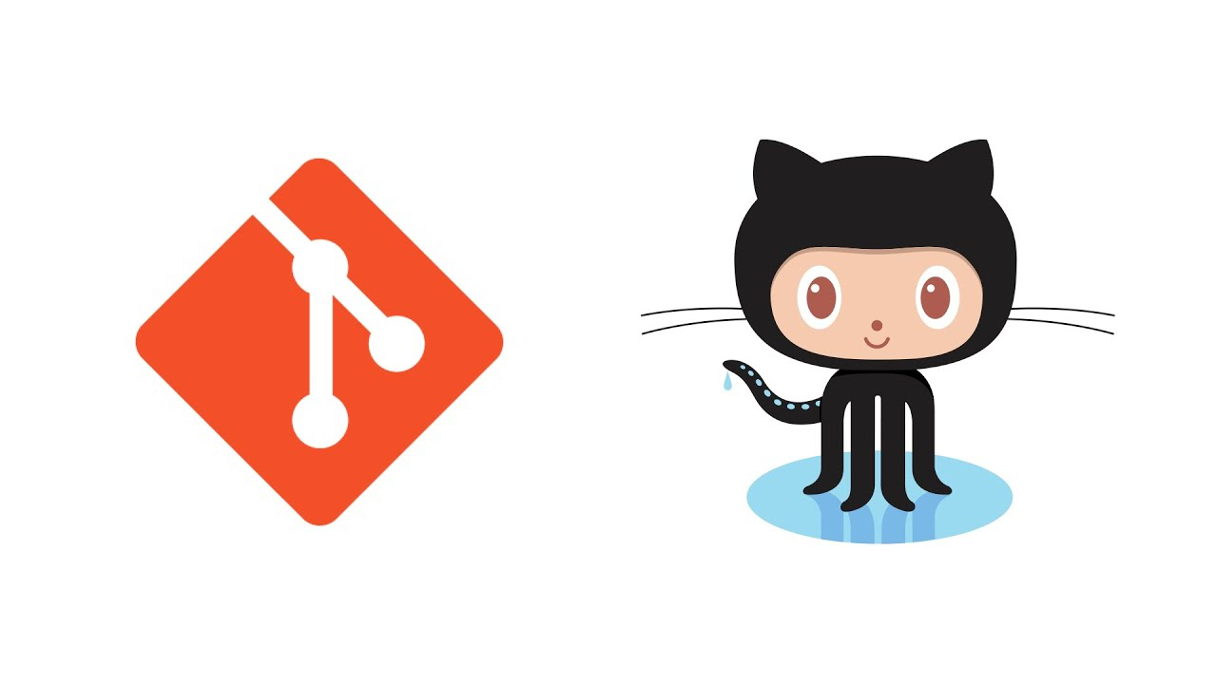
Azure Repos: Introduction
Historically version control has been the first component that teams have implemented, it is one of the oldest and most well understood components of DevOps.
Git is the most commonly used version control system today and is quickly becoming the standard for version control.

Slide 11
Azure Repos: Code Management
Branch
The first step when a developer wants to fix a bug or implement a feature is to create a new branch from our main integration branch, master. These are short-lived "topic" branches and developers are encouraged to commit early and to avoid long-running feature branches.
Push
When the developer is ready to get their changes integrated and ship their changes to the rest of the team, they push their local branch to a branch on the server and open a pull request.
Pull Request
We use Azure DevOps Pull Requests to control how developer's topic branches are merged into master. Pull Requests ensure that our branch policies are satisfied: first, we build the proposed changes and run a quick test pass. Next, we require that other members of the Azure DevOps team review the code and approve the changes.
Merge
Once all the build policies are satisfied and reviewers have signed off, then the pull request is completed. This means that the topic branch is merged into the main integration branch, master.

Slide 12
Azure Repos: Branching & Policies

Slide 13
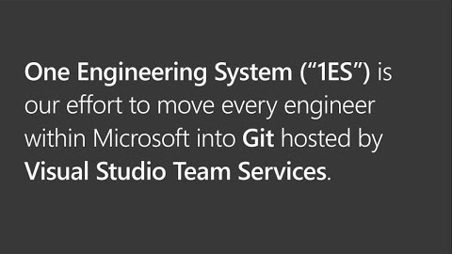
Azure Repos: Branching & Policies
Now that we understand the basics of code management, we need to implement a branching strategy.
We also want to protect our existing code from bugs as much as possible; so to ensure a minimum of standards are adhered to, we will enforce branch policies when a pull request is submitted.
Edward Thomson
Git Community program manager for Azure DevOps

Slide 14
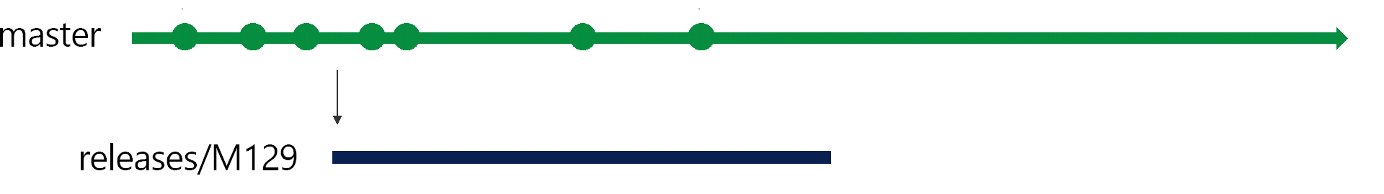
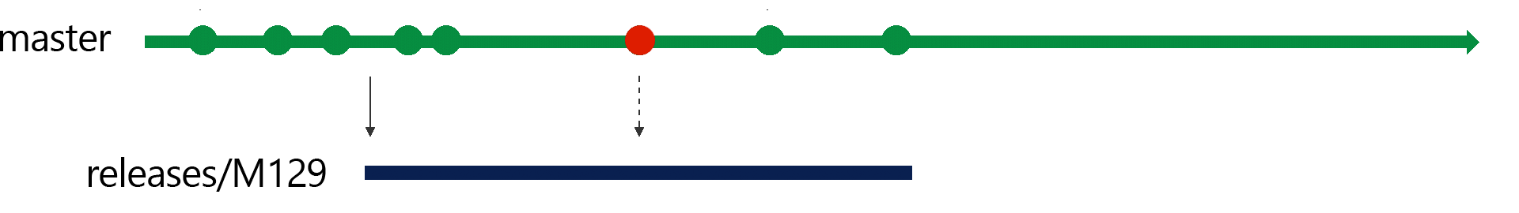
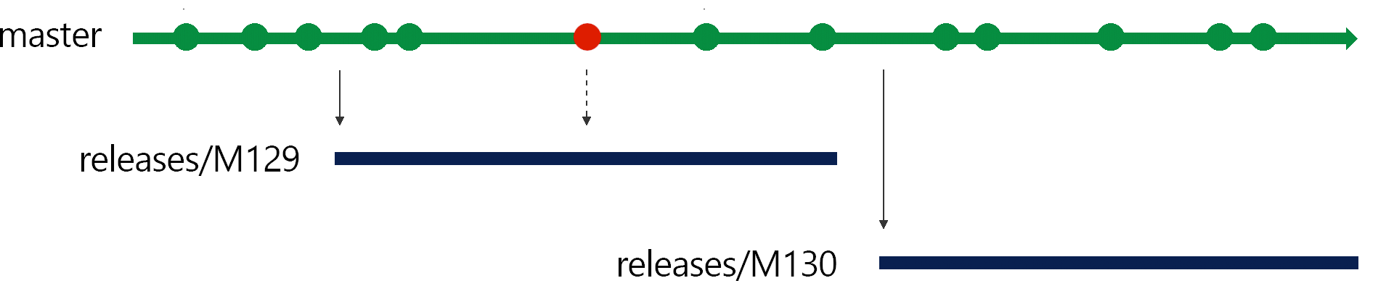
Azure Repos: Microsoft’s Branching Strategy
Release Flow
We continue developing in our master branch and batch up deployments into three week blocks, aligned with our sprint cadence.
At the end of a sprint, we create a deployment branch from the master branch: for example, at the end of sprint 129, we create a new branch releases/M129. We then put the sprint 129 branch into production.
After three weeks, we'll finish adding features to sprint 130, and we'll be ready to deploy those changes. To deploy, we'll create the new release branch, releases/M130 from master, and deploy that.

Slide 15
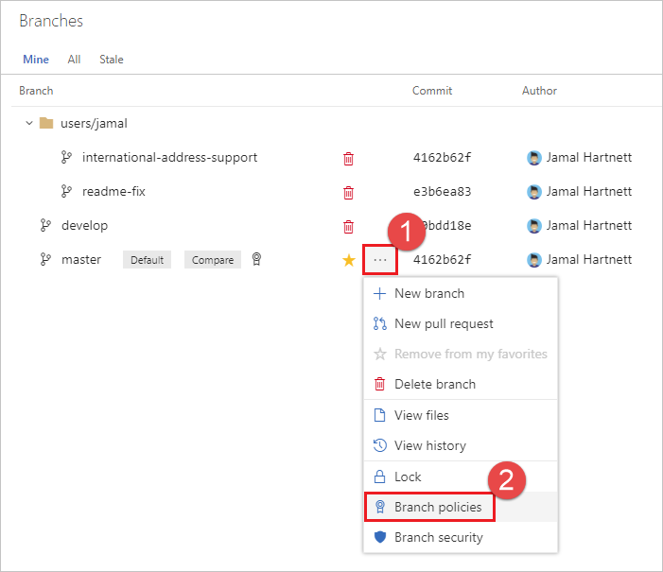
Azure Repos: Protecting Branch Integrity with Policies
Branch policies are an important part of the Git workflow and enable you to:
Isolate work in progress from the completed work in your master branch
Guarantee changes build before they get to master
Limit who can contribute to specific branches
Enforce who can create branches and the naming guidelines for the branches
Automatically include the right reviewers for every code change
Enforce best practices with required code reviewers

Slide 16
Exercise 1
Go to http://dev.azure.com
Follow instructor directions.

Slide 17
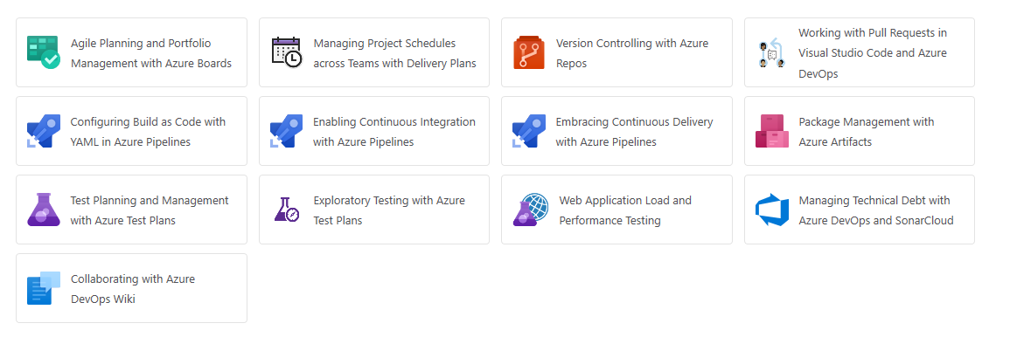
Exercise 1
Go to Version Controlling with Azure Repos
https://www.azuredevopslabs.com/labs/azuredevops/git/

Slide 18
Azure Boards: Agile Project Management

Slide 19
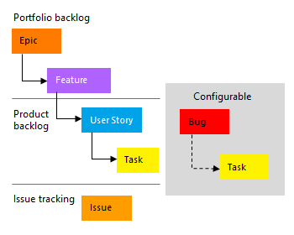
Azure Boards: Agile Project Management
What is Agile Boards?
With Azure Boards, you can quickly and easily start tracking user stories, backlog items, task, features, and bugs associated with your project. You do this by adding one of these work item types—user stories, bugs, features, epics, and tasks—that the Agile process provides. As works progresses from not started to completed, you update the State workflow field from New, Active, Resolved, and Closed.

Slide 20
Exercise 2
Go to Agile Planning and Portfolio Management with Agile Boards
https://www.azuredevopslabs.com/labs/azuredevops/agile
Complete Exercise 1, Tasks 1-5 only.

Slide 21
Azure Artifacts
Notes:
https://docs.microsoft.com/en-us/azure/devops/artifacts/?view=azure-devops

Slide 22

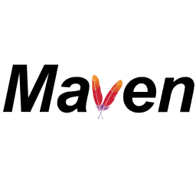
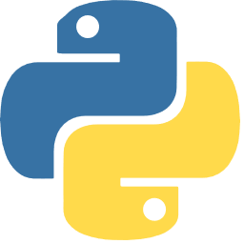
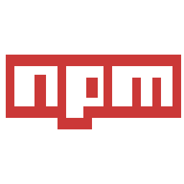
Azure Artifact: Enterprise Package Management
Multiple feeds to organize and control access to your packages.
Support for NuGet, npm, and Maven.
Key concepts:
Immutability
Recycle Bin

Slide 23
Azure Artifact features and their Compatablility
Feature | Azure DevOps Services | TFS
NuGet | Yes | TFS 2017 and newer
npm | Yes | TFS 2017 Update 1 and newer
NuGet.org upstream source | Yes | TFS 2018 Update 2 and newer
Maven | Yes | TFS 2018 and newer
Maven Central upstream source | Yes | No
Python | Yes | No
Universal Packages | Yes | No

Slide 24
Exercise 4
Go to Package Management with Azure Artifacts
https://azuredevopslabs.com/labs/azuredevops/packagemanagement/

Slide 25
End of Day 1

Slide 26
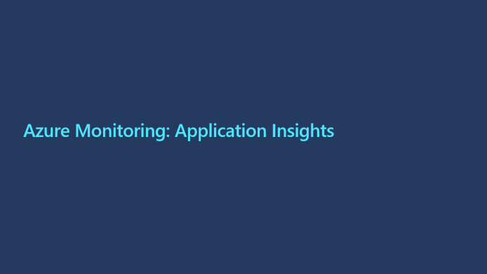

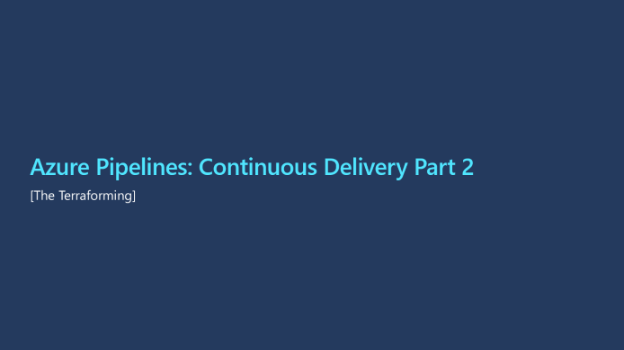
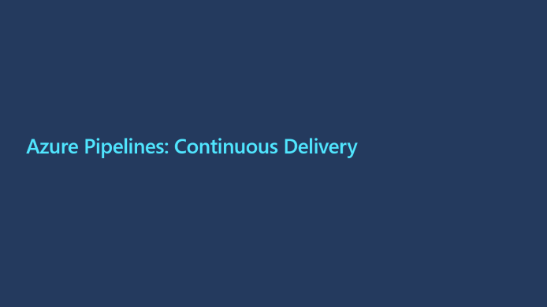
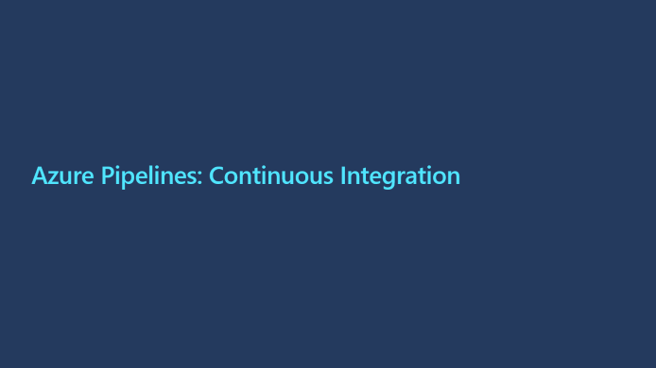
Day 2

Slide 27
Azure Pipelines: Continuous Integration

Slide 28
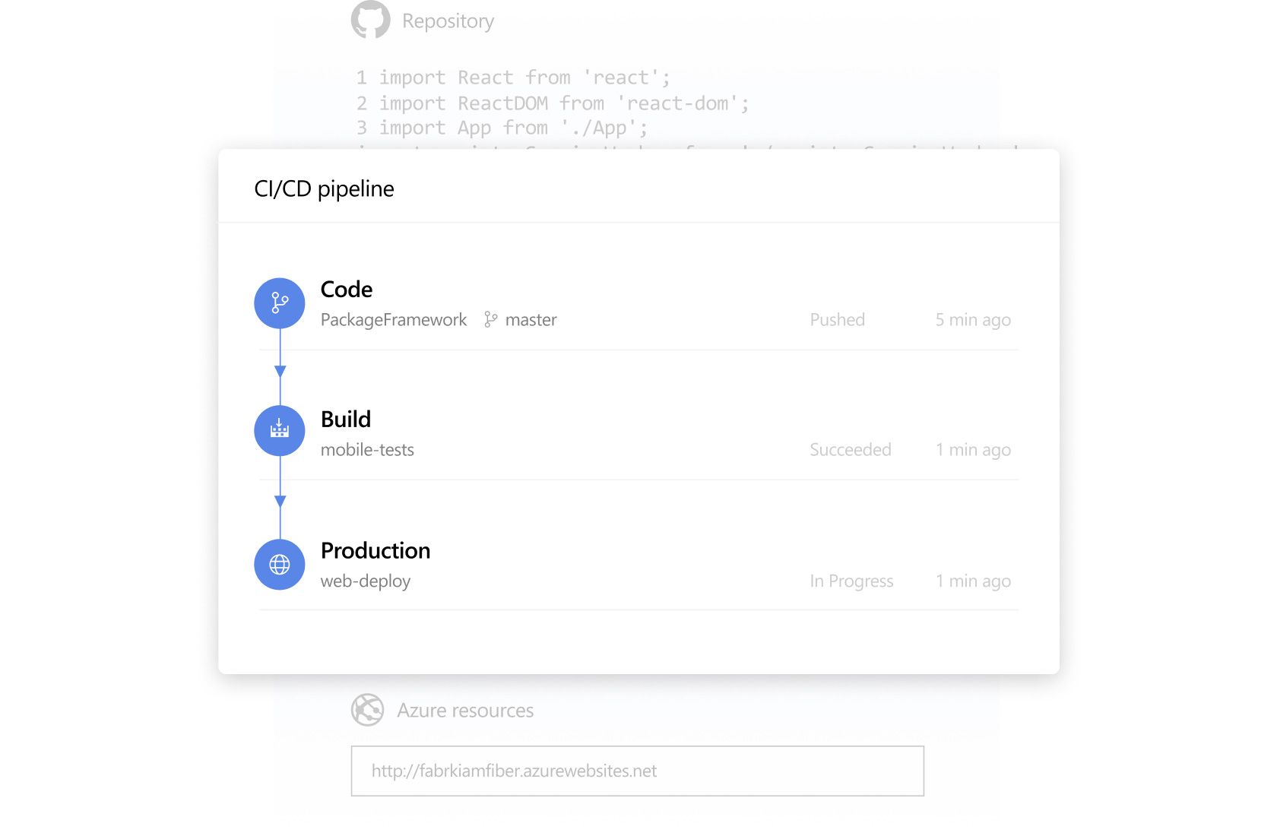
Continuous Integration
Continuous Integration (CI) is the process of automating the build and testing of code every time a team member commits changes to version control.
Teams use build definitions to ensure that every commit to the master branch triggers the automated build and testing processes. Implementing CI this way ensures bugs are caught earlier in the development cycle, which makes them less expensive to fix. Automated tests run for every build to ensure builds maintain a consistent quality.

Slide 29
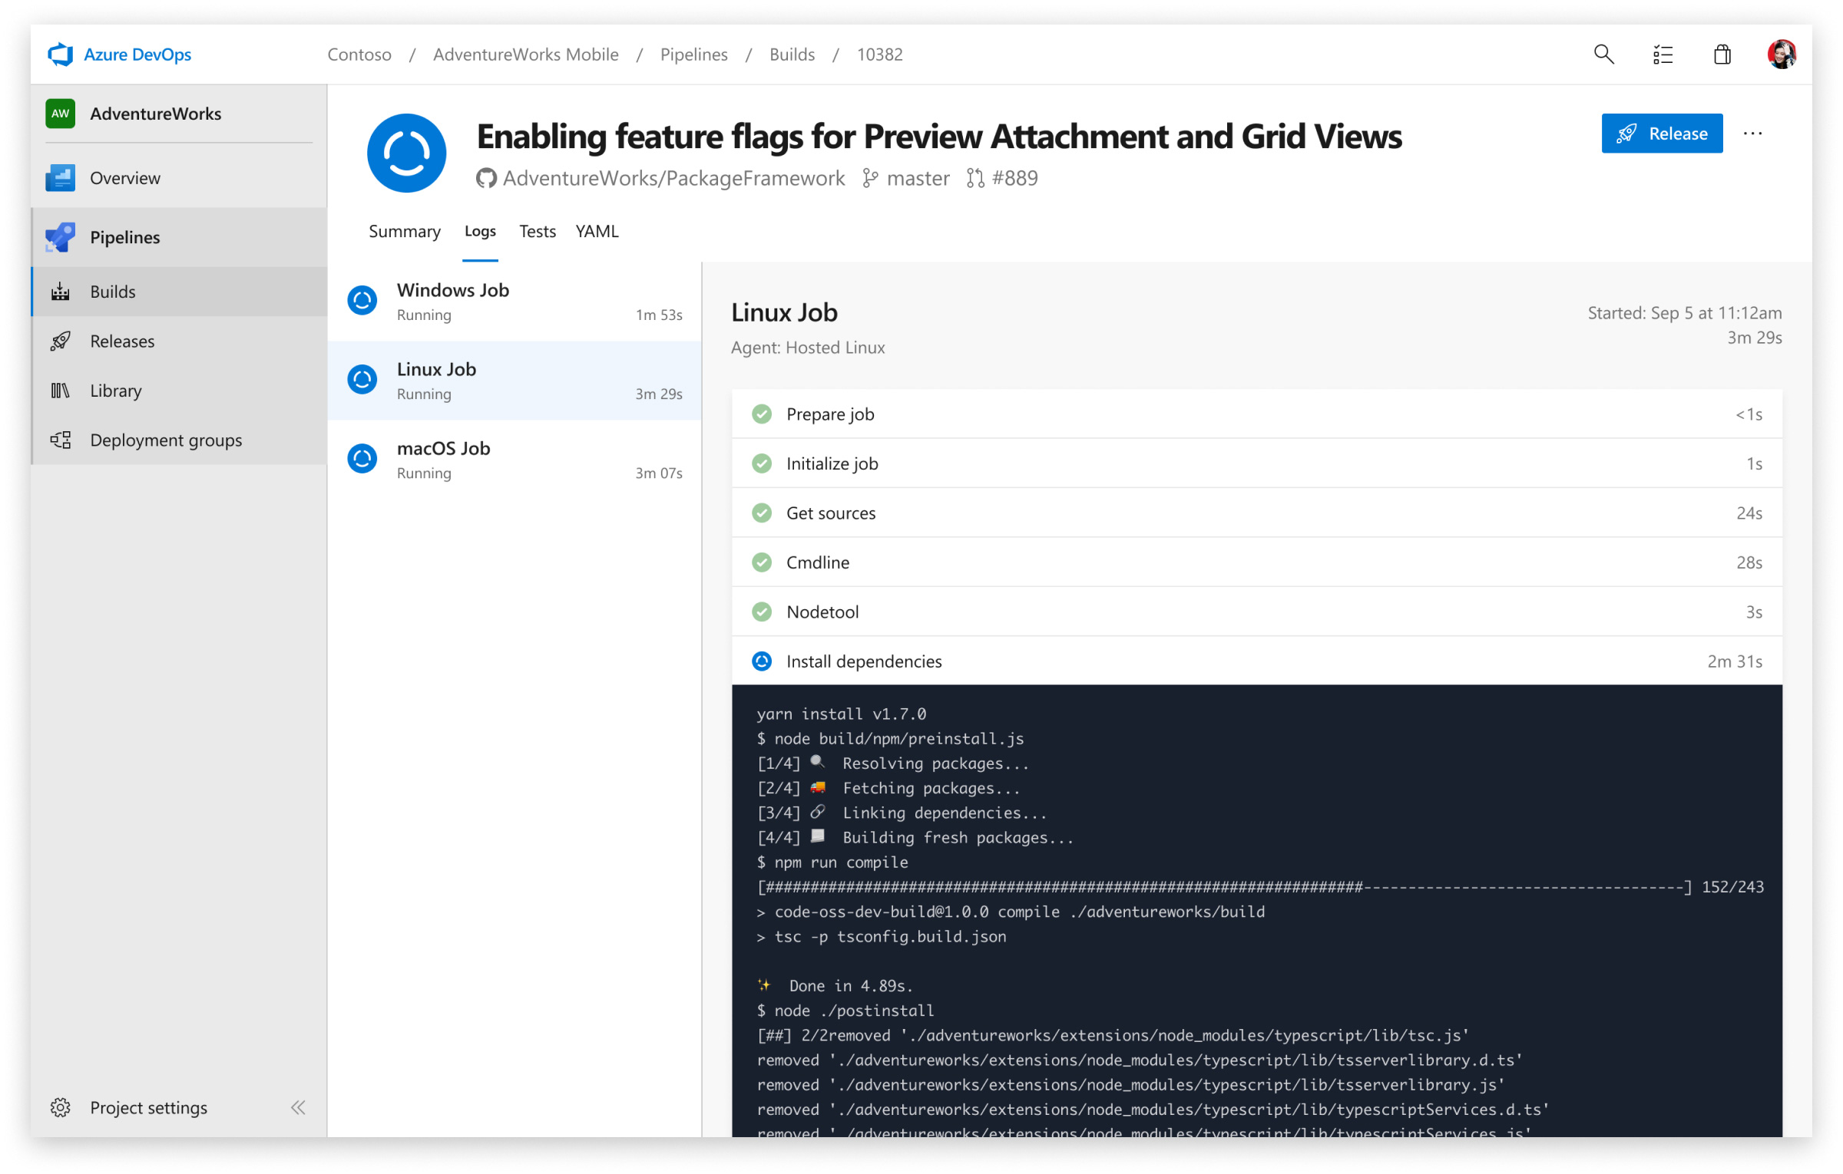
Azure Pipelines: Build Pipeline
Defining a Build Pipeline
YAML vs Classic
Enabling CI
YAML CI Configuration

Slide 30
Exercise 5
Go to Enabling Continuous Integration with Azure Pipelines
https://www.azuredevopslabs.com/labs/azuredevops/continuousintegration
Complete Exercise 1.

Slide 31
Azure Pipelines: Continuous Delivery
Notes:
Show of hands, how many of you have used an Azure release pipeline?
Of those, how many of you believe that you need a separate pipeline for each distinct environment?

Slide 32
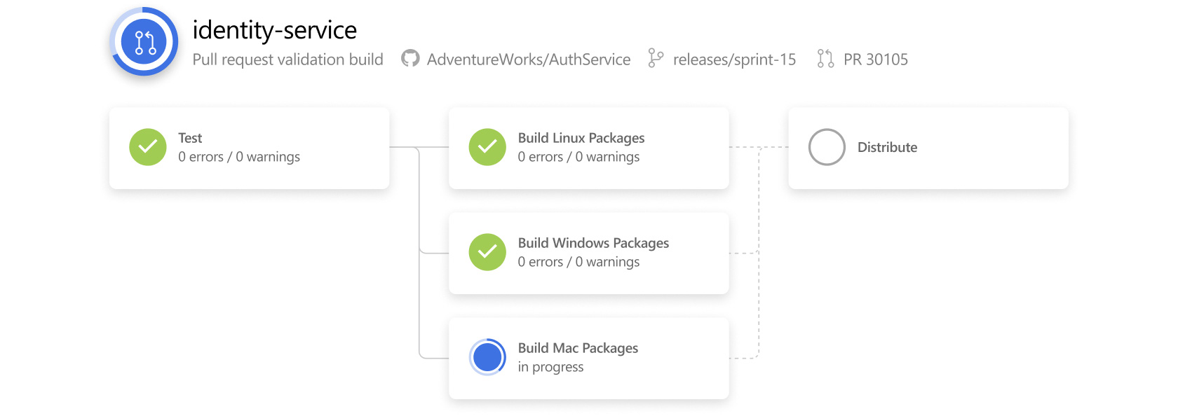
Azure Pipelines: Continuous Delivery
Continuous Delivery (CD) is the process to build, test, configure and deploy from a build to a production environment. Multiple testing or staging environments create a Release Pipeline to automate the creation of infrastructure and deployment of a new. Successive environments support progressively longer-running activities of integration, load, and user acceptance testing.
Continuous Delivery may sequence multiple deployment “rings” for progressive exposure (also known as “controlling the blast radius”).
Continuous Delivery is a lean practice. The goal of CD is to keep production fresh by achieving the shortest path from the availability of new code in version control or new components in package management to deployment.

Slide 33
Exercise 6
Go to Embracing Continuous Delivery with Azure Pipelines
Do this first: https://aka.ms/PartsUnlimitedArm
Then: https://www.azuredevopslabs.com/labs/azuredevops/continuousdeployment
Notes:
After completing lab, cover gate controls.

Slide 34
Azure Pipelines: Continuous Delivery Part 2
[The Terraforming]

Slide 35
Azure Pipelines: Continuous Delivery Part 2
Previously we delivered our product by creating a release pipeline that used Azure Resource Manager (ARM). We can also use Terraform to release our product to Azure.
Some notable take-aways when using Terraform:
By default, Terraform stores state locally in a file named terraform.tfstate. When working with Terraform in a team, use of a local file makes Terraform usage complicated. With remote state, Terraform writes the state data to a remote data store. We are going to use an Azure CLI task to create Azure storage account and storage container to store Terraform state.
The Terraform extension will need to be installed in the DevOps organization.

Slide 36
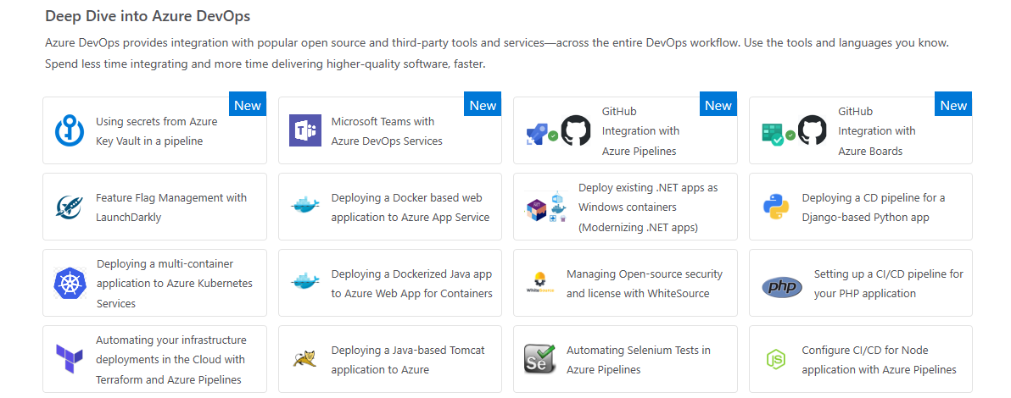
Exercise 7
Go to Automating your infrastructure deployments in the Cloud with Terraform and Azure Pipelines
https://www.azuredevopslabs.com/labs/vstsextend/terraform

Slide 37
Microsoft’s QA Journey

Slide 38
QA @ MSFT pre-2000
PMs owned understanding customer requirements and writing feature specs
Devs owned designing and coding the features.
Testers owned testing the features.
Teams had a ratio of 1 dev to 1 test to 0.5 PM, with some variance among teams.
The test discipline had two separate roles: Software Design Engineer Test (SDETs) who developed the automation, the test infrastructure etc., and then Software Test Engineer (STEs) who ran the automation or who ran manual tests.

Slide 39
QA @ MSFT post-2000: Transformation 1
Software Design Engineer Test (SDETs) and Software Test Engineer (STEs) merge.
A companywide decision was made to get rid of the STE roles and make SDETs accountable for not only developing tests but also running and maintaining automation.
This improved the model. It improved accountability and incentive on SDETs to write better and more automation. But the core problem remained. The SDETs couldn’t keep up with the code thrown over the wall.

Slide 40
QA @ MSFT mid-2000: Cloud Cadence
Shifting our quality priorities.
We pushed testing left, we pushed testing right and got rid of most of the testing in the middle. This is a departure from the past where most of the testing that was happening in the middle – integration style testing in the lab.
Shifting QA left = Testing early and often.
Shifting acceptance/user testing right = Production is a test ground.

Slide 41
Code Quality in a Cloud Cadence
How did our approach to Quality change in the Cloud cadence? We did three big things.
We redefined quality ownership, we fixed the accountability.
We understood that in order to ship frequently, Master branch must always remain as healthy as the release branch. We defined a core principle – Master is always shippable. The principle touches everything – source code management, code practices, build etc. From testing perspective, we pushed two things: shift-left testing (i.e. greater emphasis on unit testing) and eliminating flaky tests.
We also understood there is no place like production. This is the shift-right part of the strategy. It’s a set of practices about both safeguarding the production as well as ensuring quality in production.

Slide 42
Anatomy of Automated Testing
Test Taxonomy
We needed new taxonomy. Previous taxonomy was based on duration of the tests, nightly run (NAR), full automation run (FAR), etc. We created new taxonomy that was based on the measure of external dependencies. We roughly divided tests into two categories: Unit Test and Functional Tests
L0/L1 – Unit tests
L0 – Broad class of fast in-memory unit tests. An L0 test is a unit test to most people. That is a test that depends on code in the assembly under test and nothing else. <60ms execution.
L1 – A L1 test might require the assembly plus SQL or the file system. ~<400ms execution, not >2s.
L2/L3 – Functional tests
L2 – Functional tests run against “testable” service deployment. It is a functional test category that requires a service deployment but may have key service dependencies stubbed out in some way.
L3 – This is a restricted class of integration tests that run against production. They require a full product deployment.

Slide 43
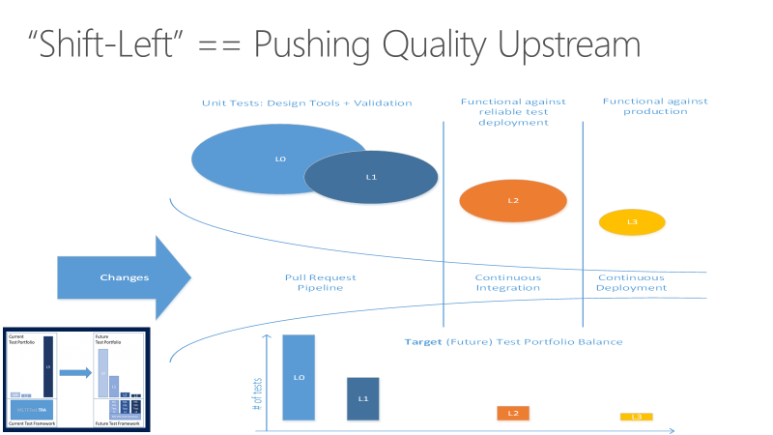
Shifting left with automation

Slide 44
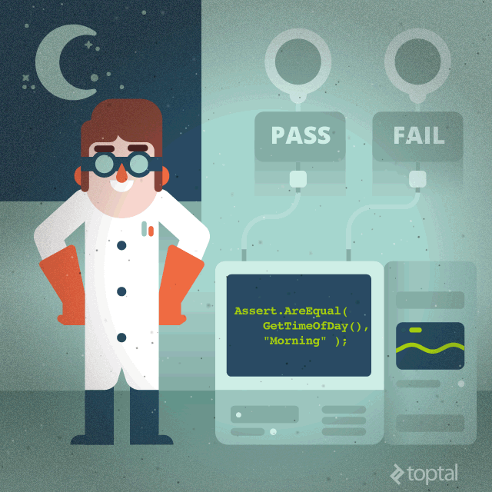
What makes a good automated test?
Easy to write
Test should be smaller, simpler
More tests are better than more complex tests
Readable
A tests intent should be clear from a simple glance
Reliable
Should only fail when it is supposed to
Fast!
Many tests add up
Slow tests get tend to be skipped
Truly unit, not integration
Credit: Sergey Kolodiy - https://www.toptal.com/qa/how-to-write-testable-code-and-why-it-matters

Slide 45
Demo
Functional Test Automation E2E Creation
Notes:
https://www.azuredevopslabs.com/labs/vstsextend/selenium/

Slide 46
Azure Test Plans: Automate Testing

Slide 47
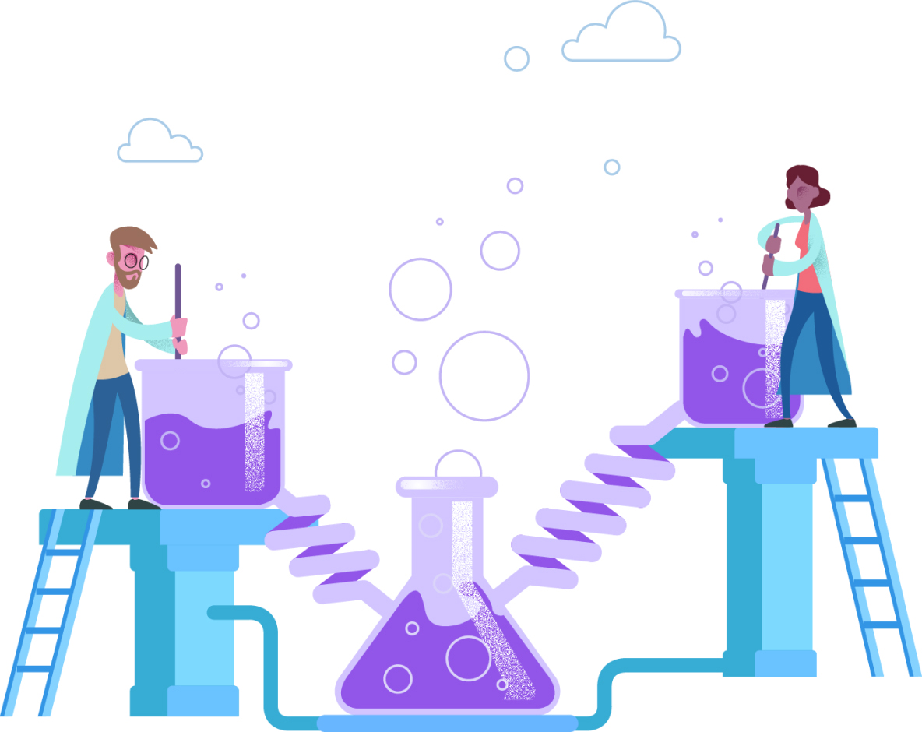
Azure Test Plans: Manual Testing
Test Planning and Management
Exploratory Testing
Load and Performance Testing

Slide 48
Exercise 8
Go to Test Planning and Management with Azure Test Plans
https://azuredevopslabs.com/labs/azuredevops/exploratorytesting/
Complete exercise 2.

Slide 49
Azure Monitoring: Application Insights

Slide 50

Azure Monitoring: Application Insights
Monitoring provides feedback from production and delivers information about an application’s performance and usage patterns. One goal of monitoring is to achieve high availability by minimizing time to detect and time to mitigate (TTD, TTM). A second goal of monitoring is to enable “validated learning” by tracking usage. “Telemetry” is the mechanism for collecting data from monitoring.
Application Insights is an extensible Application Performance Management (APM) service for web developers on multiple platforms. Use it to monitor your live web application. It will automatically detect performance anomalies.

Slide 51
End of Day 2

Slide 52
Resources
https://aka.ms/devops
https://azuredevopslabs.com
https://docs.microsoft.com/en-us/azure/devops/
Please complete a short survey:
https://aka.ms/PwCDevOpsWorkshopSurvey

